Slide 1

Florida KIDS COUNT!
Norín Dollard, Ph.D.
Department of Child & Family Studies
Louis de la Parte Florida Mental Health Institute
College of Behavioral & Community Sciences
Florida Children & Youth Cabinet
Naples, Florida August 7, 2018

Slide 2
Agenda
Annie E. Casey & KIDS COUNT
  Overview – national perspective
  2018 Databook findings
  Discussion

Slide 3
Annie E. Casey Foundation
Founded in 1949, the Annie E. Casey Foundation was created to help America’s kids have a brighter future by
  strengthening families,
  building stronger communities, and,
  ensuring access to opportunity.

Slide 4
Building a brighter future…
One way Casey achieves this is by providing reliable data analysis through the KIDS COUNT grants in all 50 states, Washington, D.C., Puerto Rico and the Virgin Islands
Casey funds these groups to collect data and report on the most critical measures of child and family well-being in their states.
http://datacenter.kidscount.org/

Slide 5
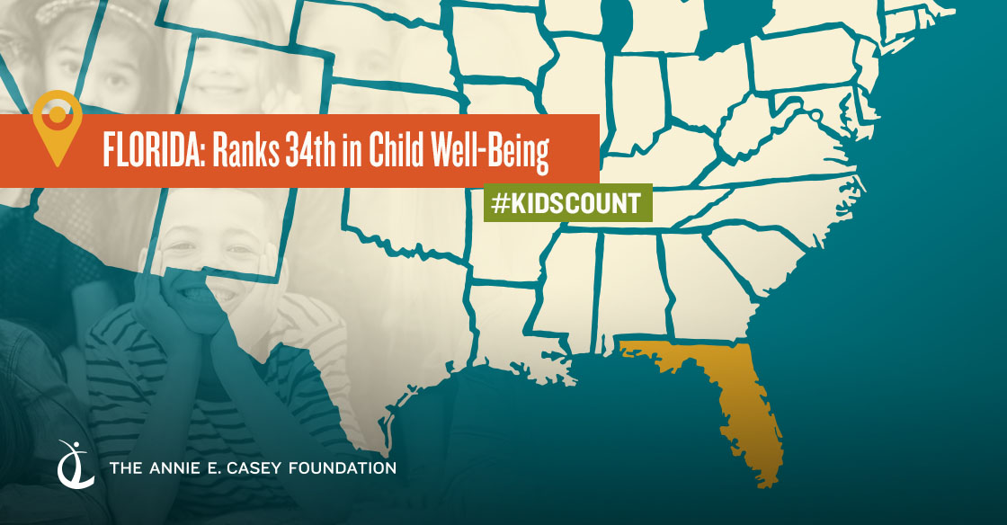
About KIDS COUNT
Notes:
The KIDS COUNT Data Book provides state-by-state data for 16 indicators of child well-being.
These indicators are organized into four domains: economic well-being, health, education and family and community. This data is used to create a composite score that allows us to rank states overall, by domain, and by individual indicators.
Every year we look at the direction in which each state is going. Each Data Book is a call to action of some kind

Slide 10
Cabinet priority areas
We are making progress, but there is much to be done.
Poverty
  Florida families need skills and education to better support their children
  We’ve made great strides in getting children health insurance – we can’t afford to lose ground
  Florida’s families need affordable housing
Notes:
Skills and education for parents - (indicators % Parents with HS diplomas, % parents with secure employment)
Health insurance

Slide 11
Cabinet priority areas
Early childhood
  Steady progress in getting young children enrolled in early childhood education, keep up the focus on quality settings

Slide 12
Cabinet priority areas
Mental health and substance abuse
  The Casey data do not speak directly to mental health indicators, but substance use (past 30 days) for youth continues to fall

Slide 13
Takeaways
Health
  We need a strong focus on well-being, to keep lowering the teen pregnancy rate, to get the number of low birthweight babies falling again, and to lower the child and teen death rate

Slide 14
Other points of discussion
Aging out of DJJ and foster care
Delays in placements

Slide 15
Thank you
Questions?
Norín Dollard, Ph.D.
dollard@usf.edu
(813) 974-3761
Like us on Facebook & follow us on Twitter @FLKidsCount

